Slide 1

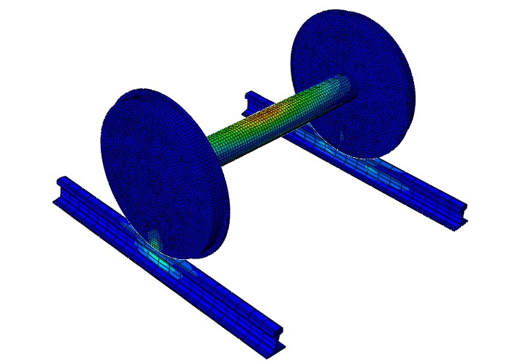
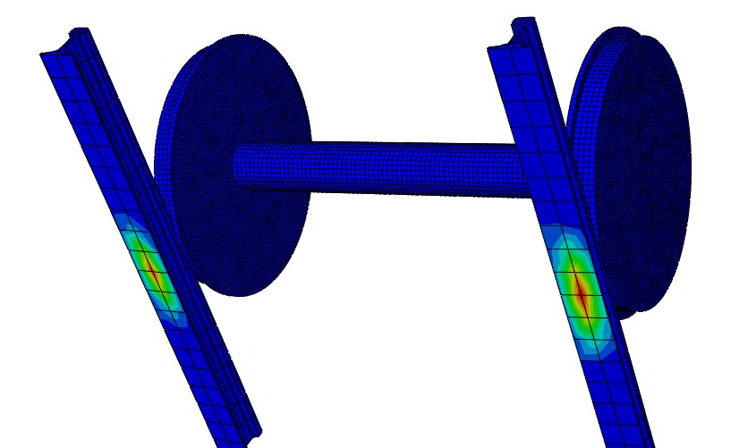
Stress Assessment in Railway Foundation System for Semi High Speed and High Axle Loads Trains.
Yerramshetty Srinivas, ADEN/ARK,ECoR ,M.tech ,RTC)&
R. P. Singh(Asst Prof Track ,IRICEN)

Slide 2
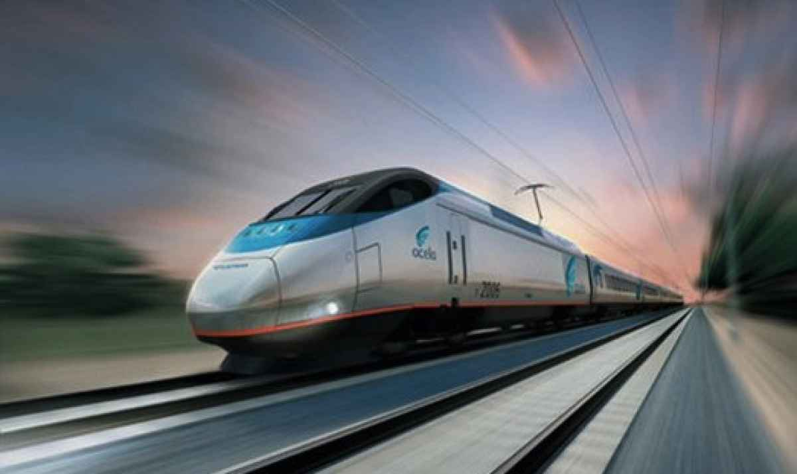
Motivation and importance:
To increase the modal share in the freight and passenger traffic.
In the context of High speed and High axle ,Assessment of stress and settlement of foundation. Much Needed exercise.
Virtual cant deficiency due to uneven settlement in case of high speed trains.
Grey area.

Slide 3
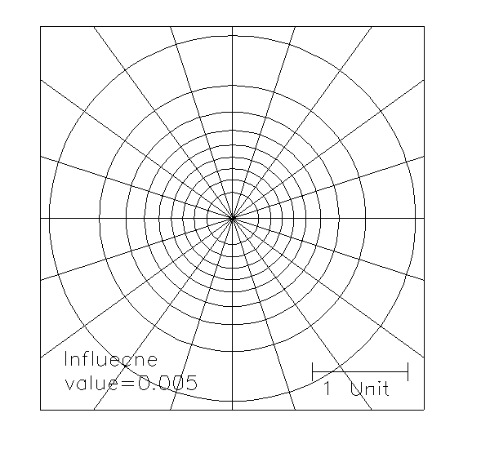
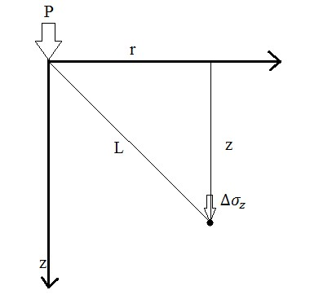

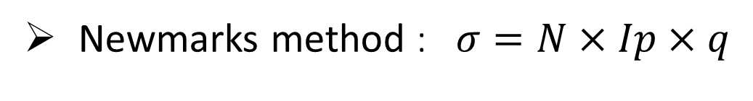


1.Analytical and Numerical Methods of Stress Determination
  Boussinessq method
      Homogeneous, Isotropic, Weightless, Linearly elastic half space
      $∆σ_{z}=\frac{3Pz^{3}}{2πL^{5}} where L={(r^{2}+z^{2})}^{\frac{5}{2}}$
  Westergaards Method :$σ_{z}=\frac{P}{2πz^{2}}\frac{\sqrt{\frac{1−2μ}{2−2μ}}}{{\left[\frac{1−2μ}{2−μ}+{(\frac{r}{z})}^{2}\right]}^{\frac{3}{2}}}$
      Includes soil property
Loaded Area
  2H: 1V method :$∆σ_{z}=\frac{P}{(B+z)(L+z)}$
Newmarks method : $σ=N×Ip×q$

Slide 4
1.Analytical and Numerical Methods of Stress Determination
  Burmister’s Method :
    Stress and displacements within two and three layer system.
    Considered both friction and frictionless interface .
    Paper I:Two layers of the system in frictional contact.
    Paper II: frictionless contact , Paper III: Three layers ,frictional contact.

Slide 5
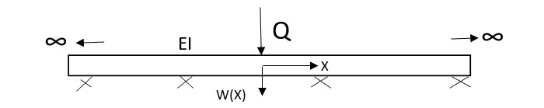
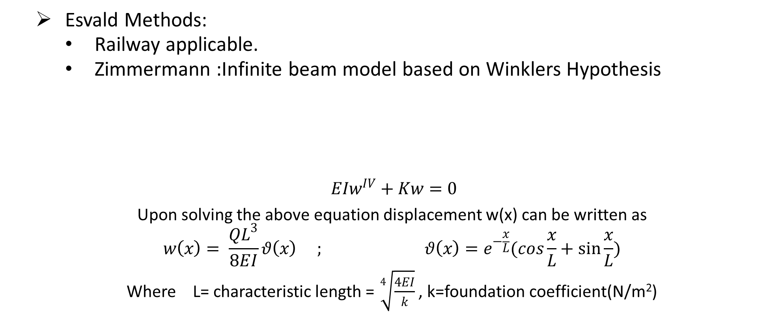
1.Analytical and Numerical Methods of Stress Determination
  Esvald Methods:
    Railway applicable.
    Zimmermann :Infinite beam model based on Winklers Hypothesis
$$EIw^{IV}+Kw=0$$
Upon solving the above equation displacement w(x) can be written as
$$w\left(x\right)= \frac{QL^{3}}{8EI}θ\left(x\right) ; θ\left(x\right)=e^{−\frac{x}{L}}(cos\frac{x}{L}+\sin{\frac{x}{L}})$$
Where L= characteristic length = $\sqrt[4]{\frac{4EI}{k}}$ , k=foundation coefficient(N/m²)

Slide 6
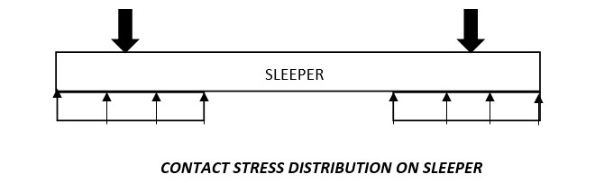

1.Analytical and Numerical Methods of Stress Determination
Calculation of bending tensile stresses in rail foot centre.
$σ_{max}=σ_{mean}\left(1+t\overline{s}\right), σ_{mean}= \frac{QL}{4W}$
W=section modulus , $\overline{s}=$ variation coefficient, t= time increment= 3
Maximum bearing force as
$K_{max}=\frac{Qa}{2L}\left(1+t\overline{s}\right)$
a= sleeper spacing
Maximum stress on ballast bed is
$σ_{max}=\frac{Qa}{2LA}\left(1+t\overline{s}\right)$

Slide 7
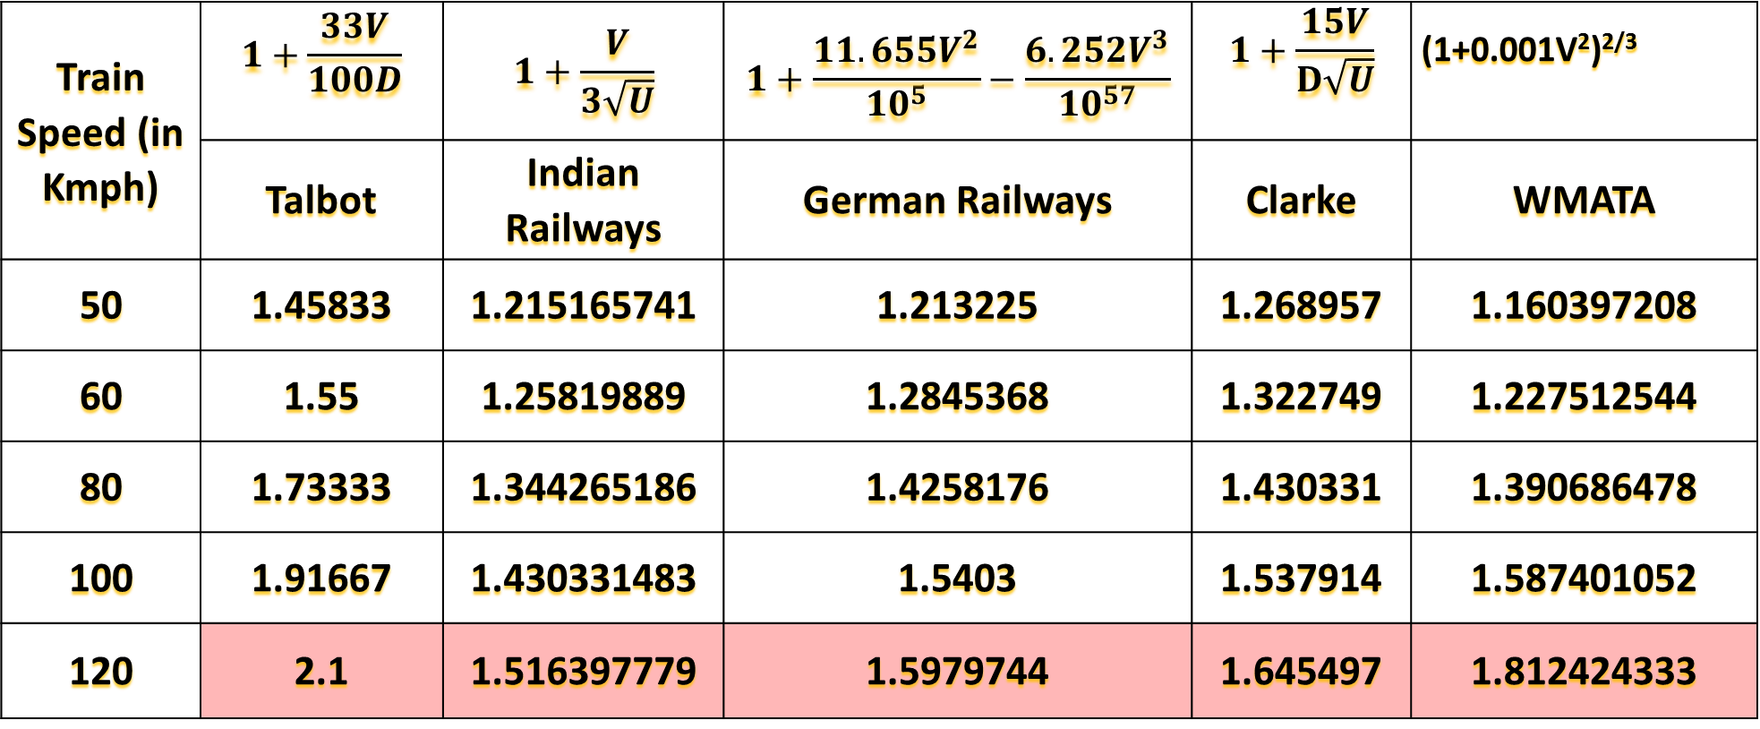
2.Dynamic augmentation factor:
Train Speed (in Kmph) | $$1+\frac{33V}{100D}$$ | $$1+\frac{V}{3\sqrt{U}}$$ | $$1+\frac{11.655V^{2}}{{10}^{5}}−\frac{6.252V^{3}}{{10}^{57}}$$ | $$1+\frac{15V}{D\sqrt{U}}$$ | (1+0.001V²)^{2/3}
 | Talbot | Indian Railways | German Railways | Clarke | WMATA
50 | 1.45833 | 1.215165741 | 1.213225 | 1.268957 | 1.160397208
60 | 1.55 | 1.25819889 | 1.2845368 | 1.322749 | 1.227512544
80 | 1.73333 | 1.344265186 | 1.4258176 | 1.430331 | 1.390686478
100 | 1.91667 | 1.430331483 | 1.5403 | 1.537914 | 1.587401052
120 | 2.1 | 1.516397779 | 1.5979744 | 1.645497 | 1.812424333

Slide 8
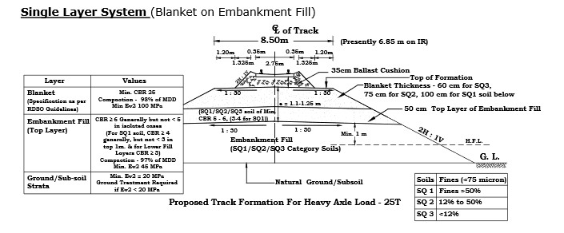
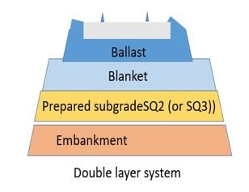
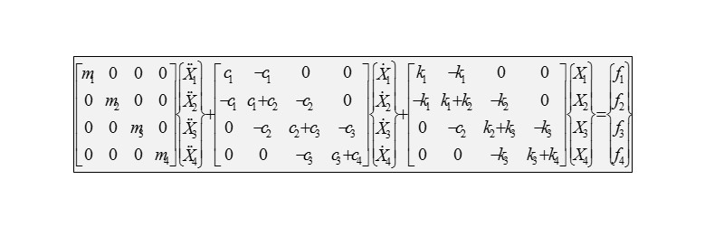
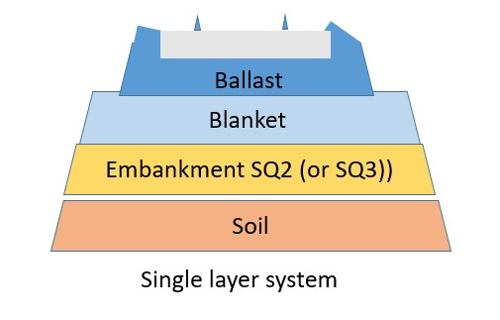
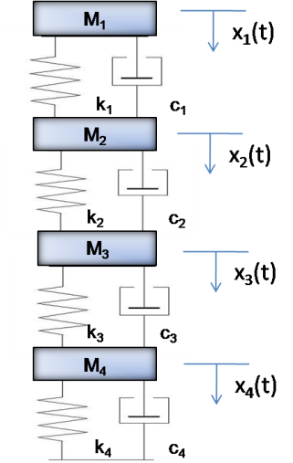
3.Method of displacement/settlement determination
Railway foundation layers and equivalent MSD Model
f₁(t)
    E= 10xCBR for CBR<5
    E= 17.6 x (CBR)0.64 for CBR >5
“Guidelines and Specifications for Design of Formation for Heavy Axle Load (GE-14)”

Slide 9
3.Method of displacement/settlement determination
The maximum displacement for different axle loads : using MATLAB

Slide 10
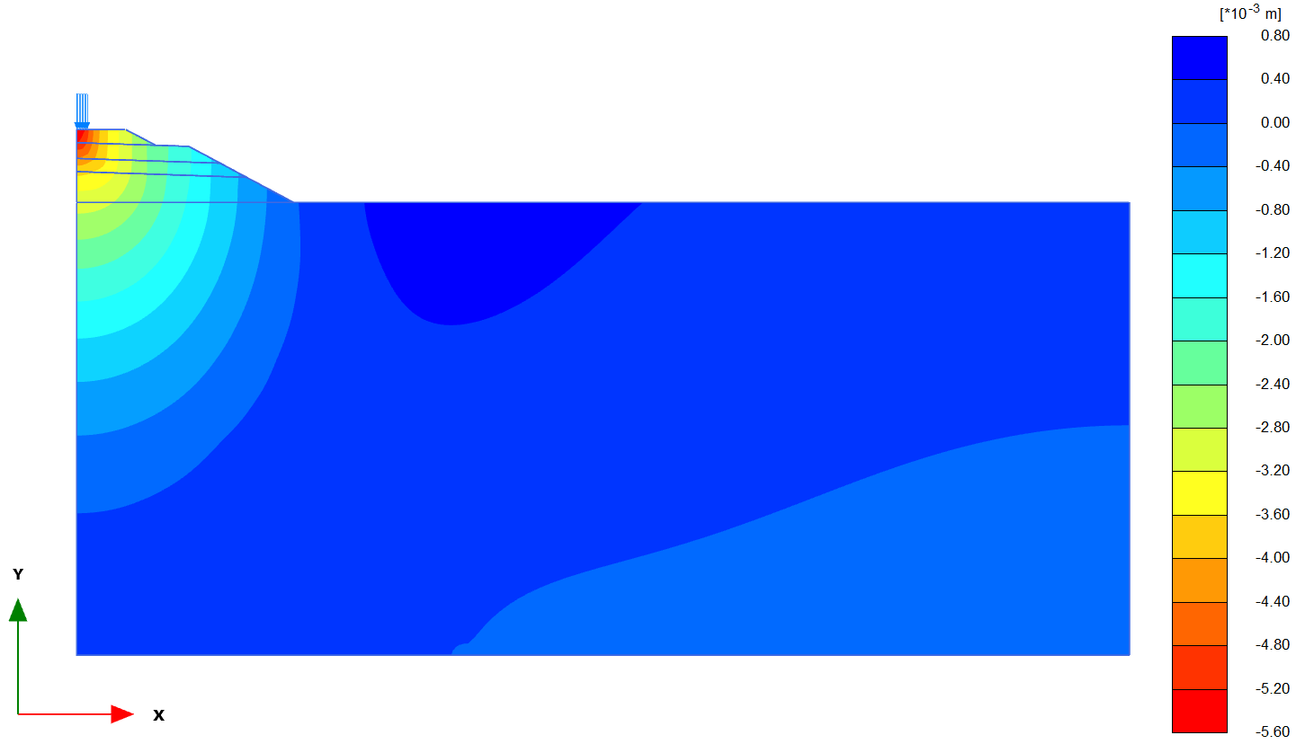
3.Analysis of New Model using PLAXIS 2D (Contd…)
Foundation | Axle Load (Tonnes) | Settlement (mm) |  | % Diff
 |  | MATLAB | PLAXIS2D
Single Layer | 25T/SQ2 | 5.73 | 5.75 | 0.34
 | 25T/SQ3 | 6.08 | 6.10 | 0.33
 | 32.5/SQ2 | 6.52 | 6.61 | 1.36
 | 32.5T/ SQ3 | 7.34 | 7.98 | 8.02
Double Layer | 25T/SQ2 | 6.15 | 6.25 | 1.6
 | 25T/SQ3 | 6.52 | 6.89 | 5.37
 | 32.5T/SQ2 | 6.87 | 7.01 | 1.99
 | 32.5T/SQ3 | 7.59 | 7.96 | 4.64
Deformation contour for single layer 25T/SQ2 railway foundation system

Slide 11
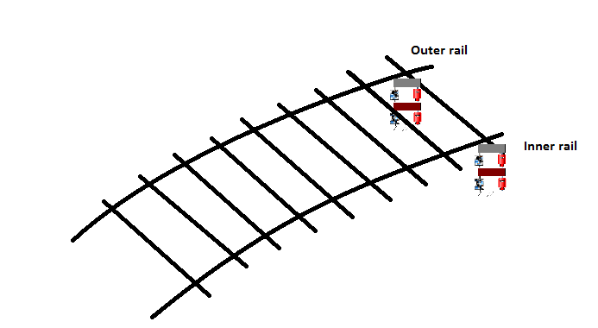
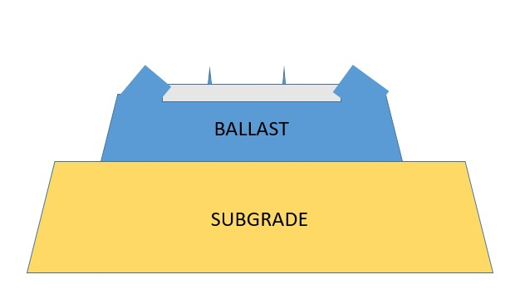
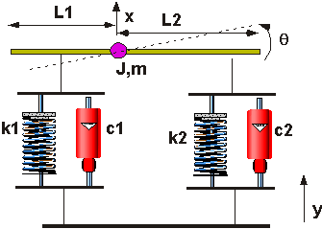
Parametric study
Parametric study on cross level in curve was done considering unequal forces on inner and outer rail.
f₂ (t)
m₂
k₂
f₁ (t)
c₂
m₁
k₁
c₁

Slide 12
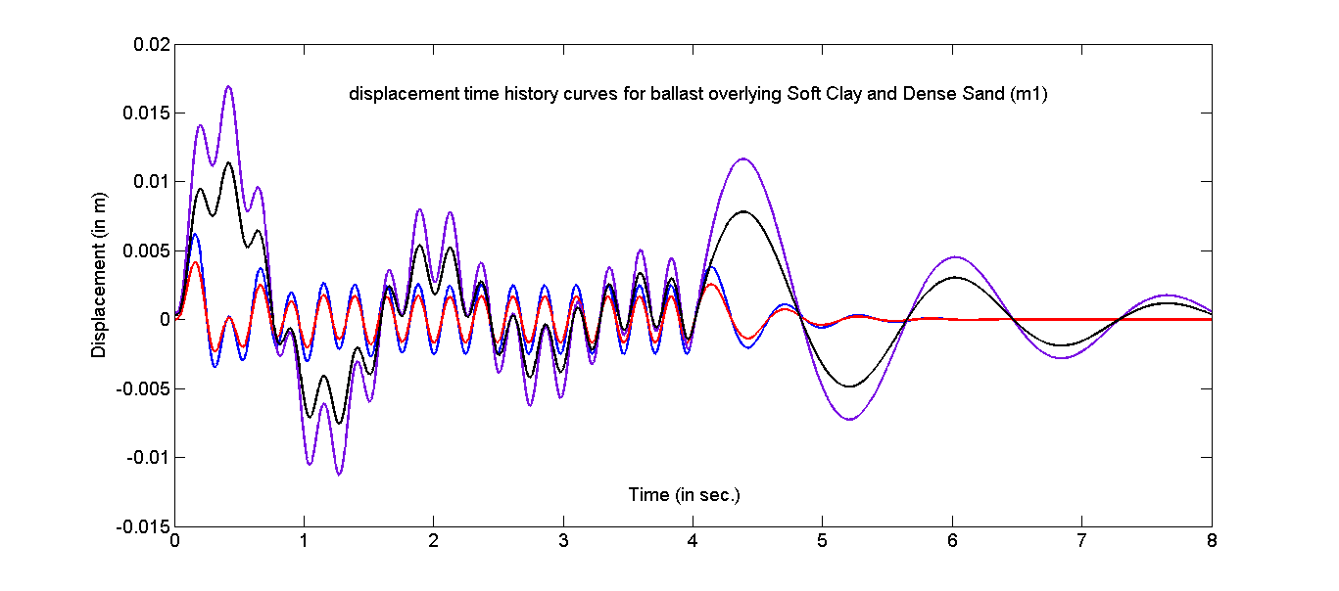
f₂ (t)
m₂
k₂
f₁ (t)
c₂
m₁
k₁
c₁

Slide 13
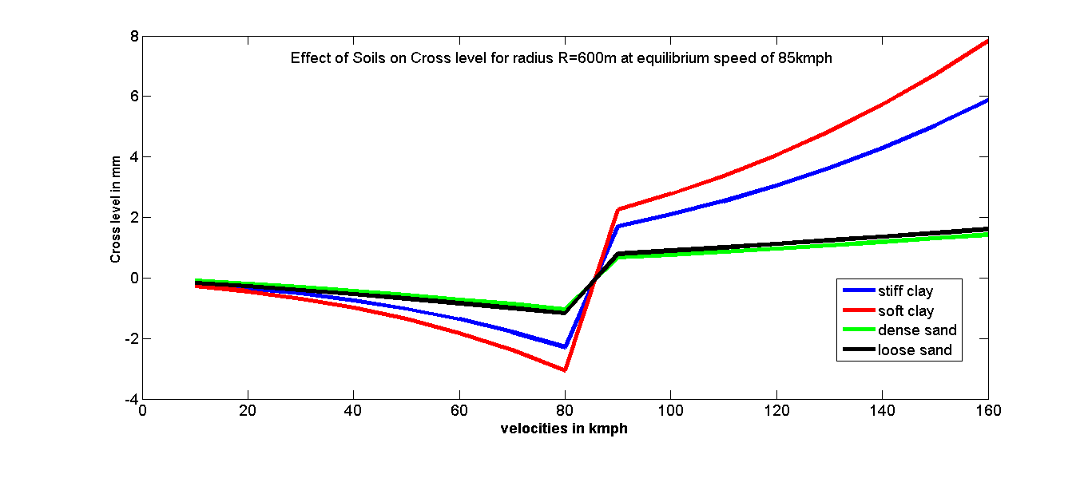
Case 1: For fixed super elevation of 165mm
Equlibrium speed = 85kmph
Study of effect of soil.

Slide 14
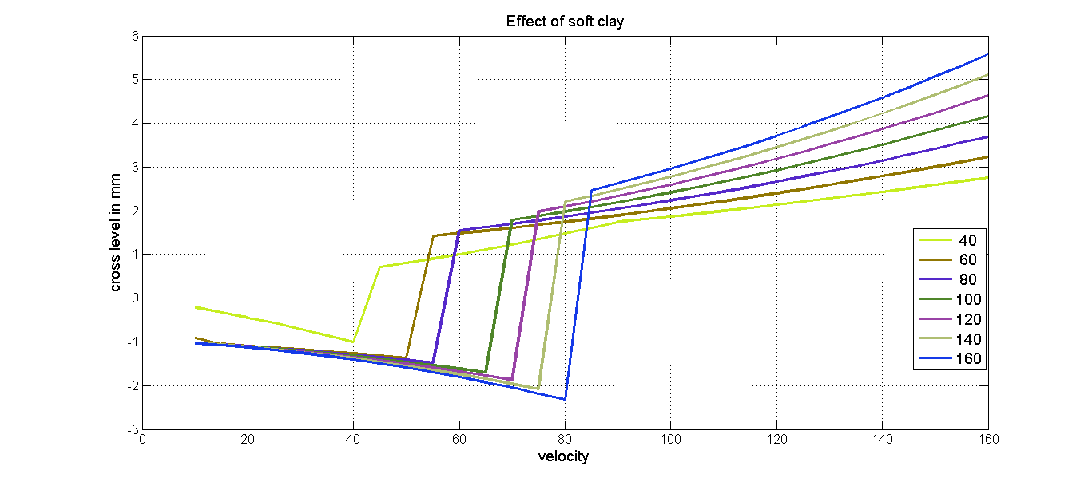
Case 2 :Varying super elevation
For each super elevation , velocity
has been varied for all four types of soil

Slide 15
Discussion and Conclusion:
Dynamic behaviour to be better assessed.
Analytical models to be developed.
Experimental work Needed.
The effect of type of soil as subgrade is quite appreciable in terms of difference in cross level.
The TWIST parameter in terms of high speed and high axle to be studied in deep for a better comprehension.

Slide 16

Thank You

